Slide 1
R-Ladies Munich News July 2017
library(dplyr)
rladies_global %>%
filter(city == 'Munich')

Slide 2
1. useR!2017 Brussels

Slide 3


Slide 4
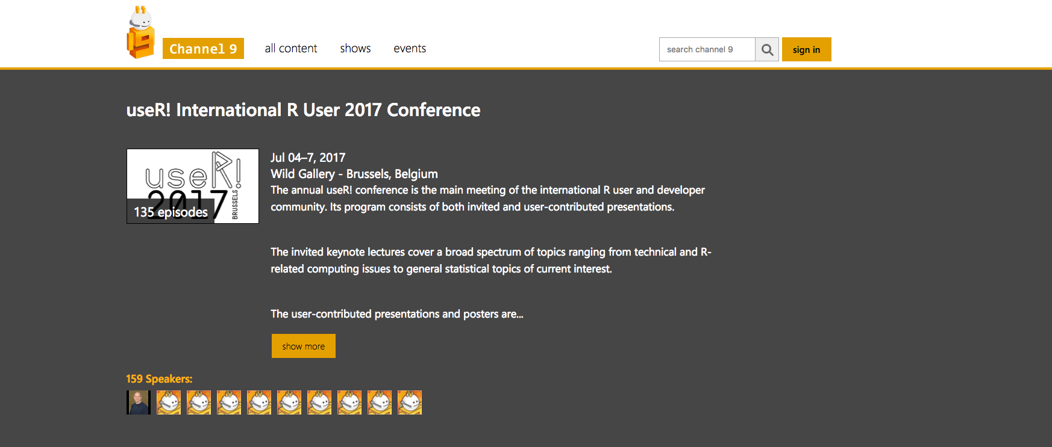
http://bit.ly/2tGAVSn

Slide 5
My top 5 useR!2017 Brussels talks
Keynote: Teaching data science to new useRs Mine Cetinkaya-Rundel
Papr: Tinder for preprints Lucy D’Agostino McGowan
Keynote: 20 years of CRAN Uwe Ligges
Text Mining, the tidy way Julia Silge
R-Ladies Global Community Alice Daish, Hannah Frick
Full program: https://user2017.brussels/schedule

Slide 6
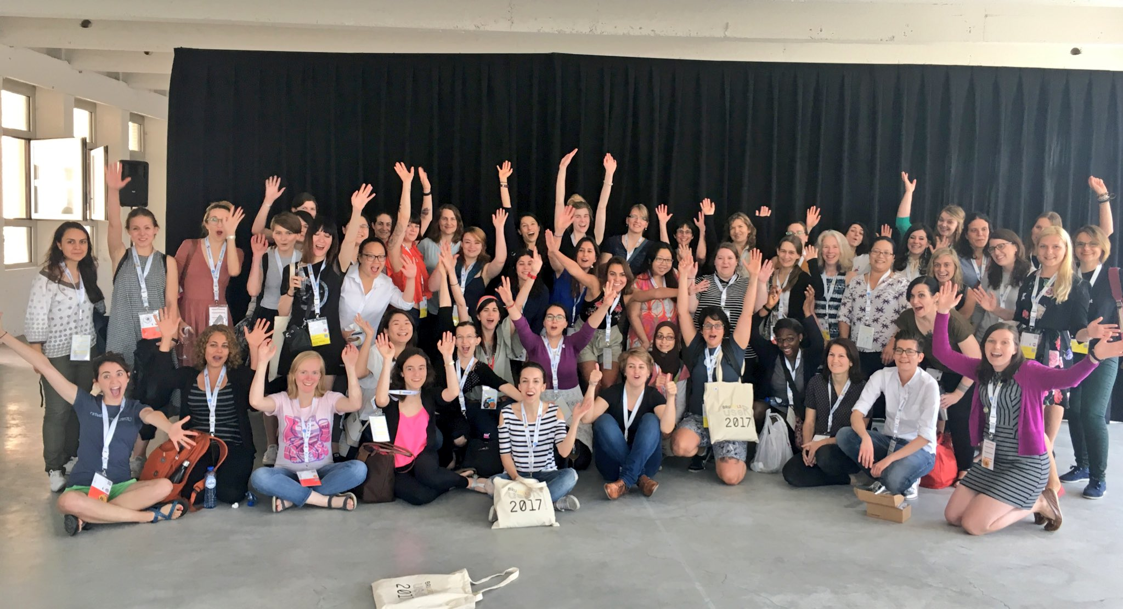
R-Ladies Lunch

Slide 7


Slide 8
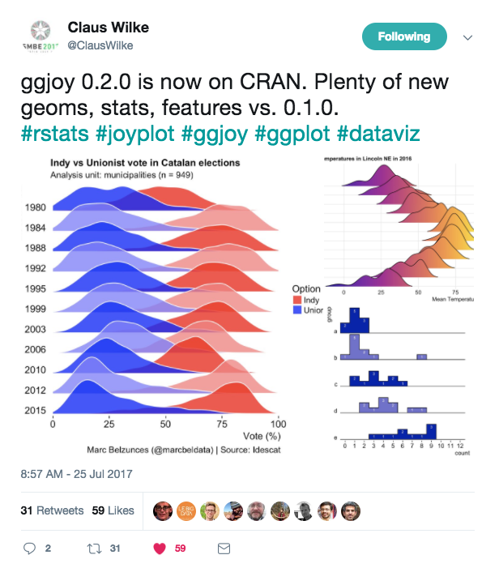
ggjoy

Slide 9
munich@rladies.org @RLadiesMunich
library(dplyr)
rladies_global %>%
filter(city == 'Munich')

Slide 10
How to set up Slack
Do one of the following:
Send us a private message on meetup telling us the email address that you’d like to use to set up slack. or
Send us an email to munich@rladies.org from the email address that you’d like to use to set up slack asking us to send you an invitation (:

